Slide 1
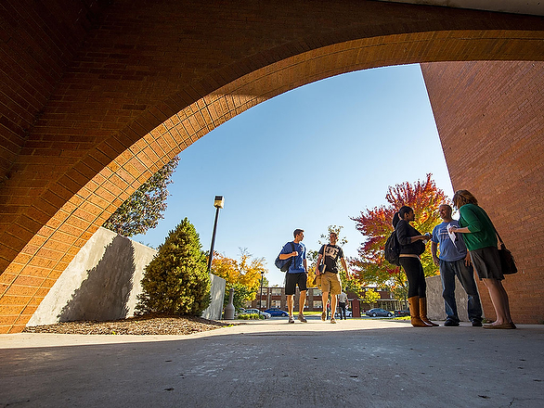
Three Strategies for Supporting Student Success in their College Marathon
Southern Illinois University Carbondale
Gregory Budzban, Chair, Department of Mathematics
Patsy Manfredi, Director, University Core Curriculum
Tamara Workman, Director, Office of the Registrar
444
July 15, 2015

Slide 2

Finishing the College Marathon
Maintain the right pace – 15 to Finish.
Stay on a pathway to success.
Intervene early to avoid setbacks.

Slide 3

Fundamental Message
15 TO FINISH
COMMIT TO COMPLETE!
Notes:
SIU has been active partners with Complete College America for about three years. One of our first steps was to influence students registration behaviors and change their focus from getting to college, to completing a degree. We started with a very simple messaging strategy designed to ensure consistent delivery and reinforcement.
In 2012 we included the 15-to-Finish “Commit to Complete” message in our Academic Preparedness presentation during New Student Orientation, and on the SalukiNet student portal. This message is seen at multiple times throughout orientation, staged to engage the attention of students and families. SIU wanted to clearly identify itself as an institution that is committed to student success through degree completion. This slide is used to open and close the presentation where students are also asked to verbally commit to completing their degree as a part of the program. I might add that we have recently re-titled this presentation to “Commit to Complete!”

Slide 4
Best Strategy to Ensure Completion
Minimize cost and optimize opportunity
15 TO FINISH
COMMIT TO COMPLETE!
Complete your degree!
  4 Years
  8 Semesters
  15 Credit Hours a Semester
Notes:
We deliver the message again in an actionable sense during the presentation, reminding students to minimize cost and optimize opportunities by completing their degree in four years. We review general graduation requirements stating that the bachelor’s degree is designed for a four-year completion; 8 semesters and 15 credit hours each semester. Staying on track to graduate in 4 years requires that the student stay fulltime during the fall and spring, but if this is not possible, taking classes in the summer will keep them on track and in sequence; making sure 30 hours is completed each year. We suggest they consider taking an extra class if and when they can. Because our tuition is capped at 15 hours, the additional hours would be free, possibly allowing the degree to be completed in 3 years; a plan that enables the student to enter the job market sooner AND greatly reducing the cost of their education.

Slide 5
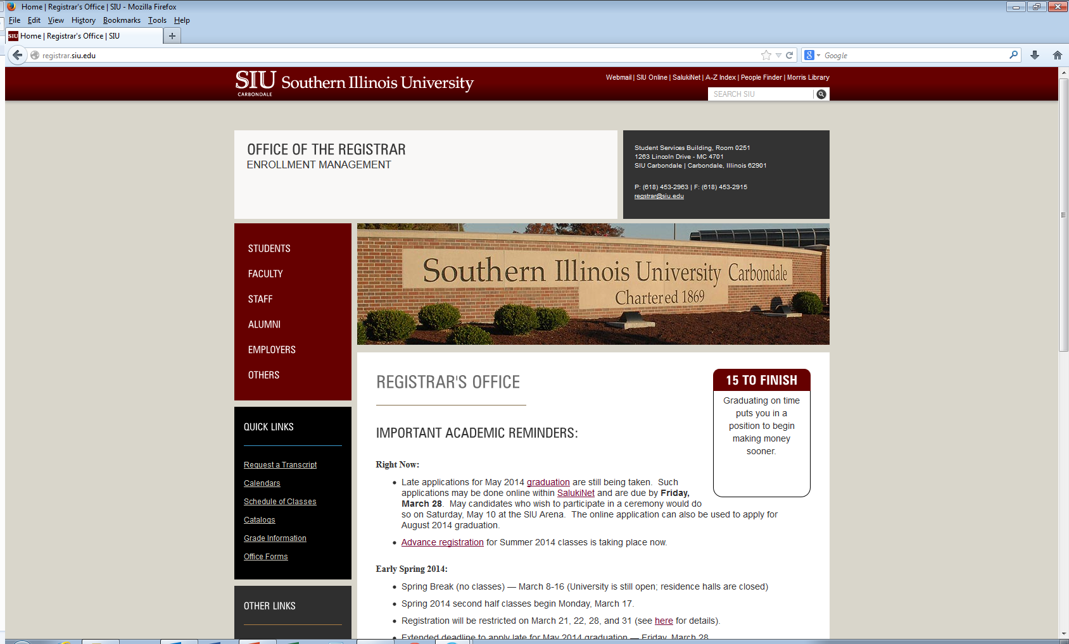



Notes:
We also put a revolving 15-to-Finish message on the Registrar.siu.edu page where we have Important Academic Reminders. We included several advantages to completing the degree in 4 years, tell students to see their academic advisor, and taking summer classes.

Slide 6
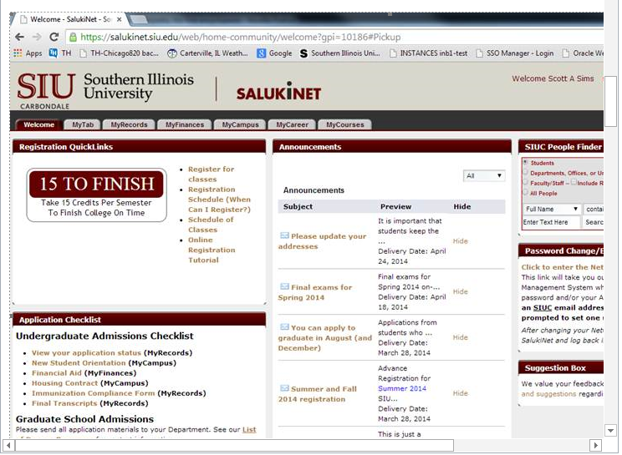
Notes:
Here’s an example of the 15 To Finish reminder at the SalukiNet student portal as well as a job aid that is used in advisement that again reinforces the 15-to-Finish message and provides action items. Our Major Maps are a high level guide for all four years designed to draw attention to
Taking the right classes – list critical and prerequisite classes
Utilizing Academic Advisement and Faculty Mentors
Take advantage of student work opportunities, externships, and internships
Getting involved with student and professional organizations, academic fraternities, and community service
Career or graduate school preparation

Slide 7
Notes:
Here is an example of how we included the completion message in our marketing piece for summer registration. “Stay on Track. Finish Faster.”

Slide 8
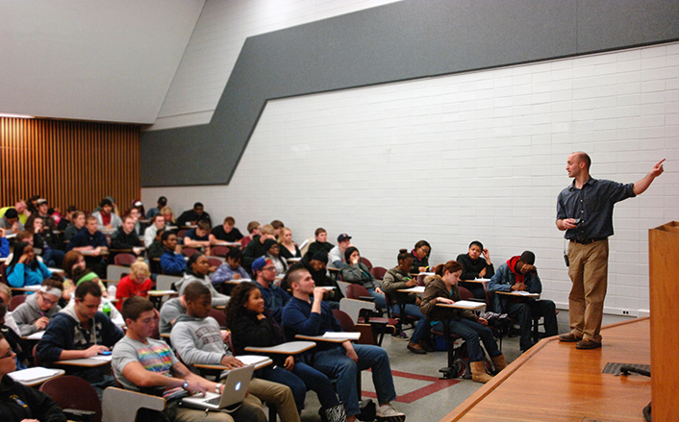
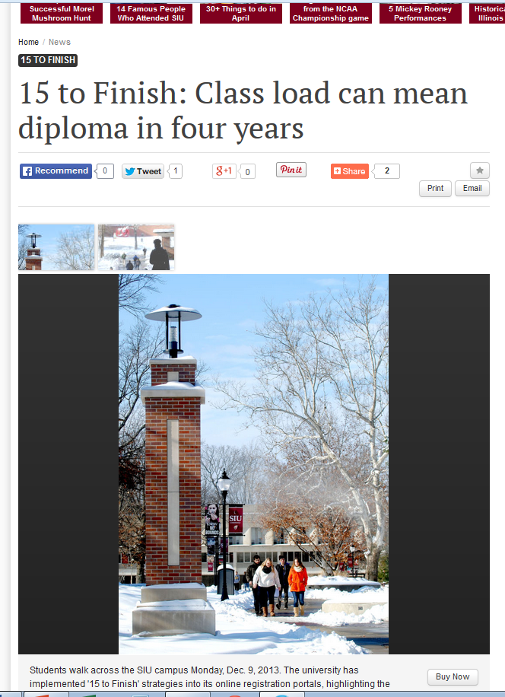
“… we are promoting 15 to Finish because we’re finding students are getting better grades with 15 credit hours...”
Notes:
We shared the message to the greater University and region with communications featuring our implementation of the “15-to-Finish” strategies. This particular article provides informative data about completion rates and that we find students who take 15 semester hours make better grades.

Slide 9
+1.67%
Notes:
With just a few low or no-cost well-placed strategies we were able to increase the number of undergraduate students taking 15 or more semester hours right away. We were pleased with a modest 1.7% increase the first year, and very excited to see the 6.4% increase the following fall. We’re seeing positive outcomes with these simple but powerful strategies…and, we’re excited about the prospects for further growth in fall 2014!
Fall 2011 5,442 Fall 2012 5,533 1.67% Fall 2013 5,889 6.43%

Slide 10
Finishing the College Marathon
Maintain the right pace – 15 to Finish.
Stay on a pathway to success.
Intervene early to avoid setbacks.

Slide 11
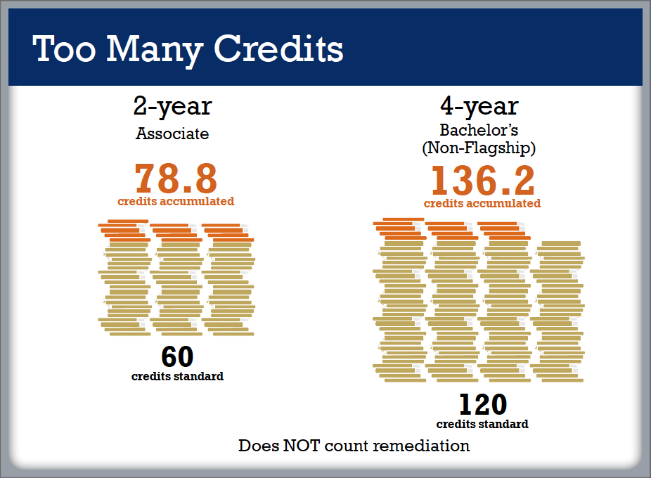
Notes:
Encouraging students to take 15 credit hours per semester, is part of the solution to increase our 4-year graduation rate. It is not the whole solution.
As this slide from Complete College America shows many students take far more credits than most programs require to graduate.

Slide 12
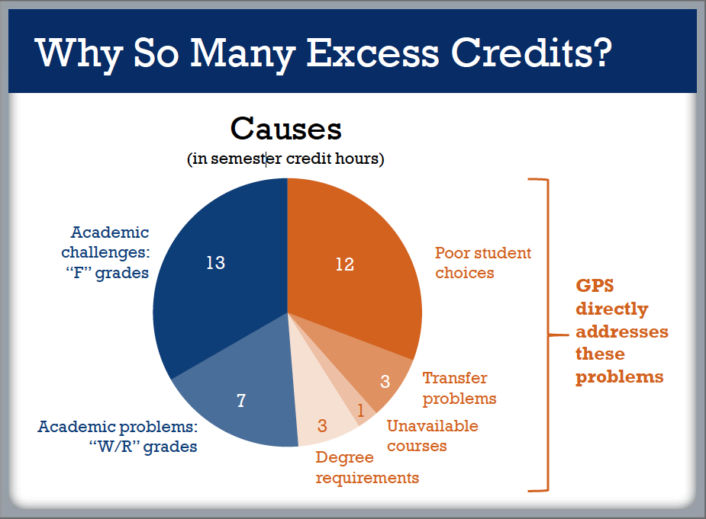

Slide 13
Guided Pathways to Success
Curricular designs containing “default choices” for students, leading them to make informed, deliberate decisions that are in their best interests given their educational goals.

Slide 14
Life and Chemical Sciences Meta-Major
LIFE AND CHEMICAL SCIENCES
META-MAJOR
FIRST-YEAR CORE
FALL 1
SPRING 1
BIOL 200A 4 CH
MATH 108 3 CH
CHEM 200,201,202 5 CH
UCOL 101 1 CH
ENGL 101 3 CH
BIOL 200B 4 CH
MATH 109 3 CH
CHEM 210,211,212 5 CH
ENGL 102 3 CH
M
M
M
Milestone course
required this semester
M
M
15 CH
16 CH
MAJORS
Biological Sciences, Microbiology, Physiology,
Plant Biology, Zoology, Chemistry
Notes:
We have introduced guided pathways for many students in the College of Science.
This chart represents the guided pathway for students seeking to major in the Life or Chemical Sciences.
It represents a common curriculum, a meta-major for all students in the majors listed here.
These pathways simplify the process of academic advising because freshmen don’t have to “decide” what courses to take.
The pathways guarantee that students are taking at least 15 credit hours per semester.
The pathways identify “milestone” courses that help track student progress towards the degree.
The pathways contain courses that simultaneously satisfy both general education requirements and requirements in the college or major.

Slide 15
Math/Physics/Computer Science Meta-Major
INFORMATION AND COMPUTER SCIENCE
META-MAJOR
FIRST-YEAR CORE
FALL 1
SPRING 1
MATH 150 4 CH
CS 202 4 CH
ENGL 101 3 CH
UCOL 101 1 CH
SPCM 101 3 CH
MATH 221 3 CH
PHYS 205A,255A 4 CH
MATH 250 4 CH
ENGL 102 3 CH
UCC Human Health 2 CH
or CS 215 or 4 CH
M
M
M
Milestone course
required this semester
M
M
*
15 CH
16-18 CH
MAJORS
Computer Science, Mathematics, Physics
*
Students on Mathematics or Physics track take UCC Human Health;
those on Computer Science track take CS 215
Notes:
This is a guided pathway for students in a math, physics, or computer science meta-major.
These majors in the College of Science are the low-hanging fruit of a curriculum.
Their shared structure, makes designing guided pathways for them relatively easy.
Extending guided pathways to more loosely structured majors, such as those in the Liberal Arts will be more difficult.
But in coming semesters, we will be pursuing this goal on two fronts:
First, departments will be reviewing curricular guides for their majors and we will be looking for areas of common overlap.
Second, we are exploring a general education redesign that integrates general education courses with meta-majors in an effort to get all students on guided pathways as soon as possible.

Slide 16
Finishing the College Marathon
Maintain the right pace – 15 to Finish.
Stay on a pathway to success.
Intervene early to avoid setbacks.

Slide 17
Gateway Math Courses Trends
  22% of students require mathematics remediation
  Remedial courses are rarely effective
  Research indicates that the more required developmental courses a student must take, the lower the student’s probability of successful degree completion.

Slide 18
SIU Math Courses
  Math 101 – Introduction to Contemporary Mathematics
    (Non-STEM majors, satisfies general education requirement)
  Math 107 – Intermediate Algebra
    (Includes STEM/Business majors, no credit towards degree, “remedial” course)
  Math 108 – College Algebra
    (Includes STEM/Business majors, credit towards degree, satisfies general education requirement)

Slide 19
Early Warning Intervention Platform
Week 3
25%* (Preparation) + 25%* (Motivation) + 50%* (Demonstration)
RED: 0% to 55%
ORANGE: 56% to 65%
YELLOW: 65% to 75%
GREEN: 76% to 100%
Students also receive an intervention score in week 8 and week 12 that is simply their course grade at that time.

Slide 20
College Algebra Data
Fall 2013

Slide 21
Markov Models of Student Performance
0.81
0.11
0.38
0.32
0.05
0.03
0.19
0.11
0.08
0.14
0.03
0.28
0.02
0.28
0.24
0.63

Slide 22
Markov Models of SIU College Algebra
Fall 2013 – Week 8 to Final grade
0.95
0.61
0.39
0.09
0.05
0.31
0.69
0.91

Slide 23
Predictive Value of Week 8 Grades
College Algebra : Success rate of Week 8 metric (C or better)
  Red 13/138 (9.3%)
  Orange 29/94 (30.8%)
  Yellow 70/114 (60.5%)
  Green 283/298 (94.9%)

Slide 24
EW Pilot Fall 2014-COS/COB
The EW data suggests that “getting green” by week 8 is the pathway to success.
Colleges of Science/Business pilot targeted “yellow alert” students in Fall 14
  Goal: 50% “Yellow-to-Green” by week 8.

Slide 25
Outreach Efforts
Academic Affairs
Upper level Administration
  Support and understanding of goal
Faculty involvement
  Intentional letters to students on effort
  Reframe to positive
  Invest in student Experience in classroom

Slide 26
Outreach Efforts
Student Affairs
College-level Retention Staff
  Devised protocol for timeline of interventions
  Set tracking methods to collaborate across departments
  Shared common data with key constituents at the university
  Followed up with feedback survey at the beginning of the spring semester
First-year advisors
  Contacted the students via phone, email
  Tracked responses in EAS
Housing staff
  RA involvement with study sessions

Slide 27
Markov Models of SIU College Algebra
Fall 2014 Pilot
0.38→0.425
0.32→0.425
Increased the students in the top two categories from 70% to 85% .
An increase of 21.5% in one semester!
0.19→0.09
0.11→0.06

Slide 28
Markov Models of SIU College Algebra Fall 2014 – Week 8 to Final grade
0.94
0.69
0.31
0.06
0.08
0.29
0.71
0.92

Slide 29
College Algebra Data
Fall 2014

Slide 30
SIUC Gateway Mathematics
Success Trend Lines

